Slide 1

Chapter 13
Preparing for and Evaluating the Challenges of Growth
Bruce R. Barringer
R. Duane Ireland
Copyright ©2012 Pearson Education, Inc. publishing as Prentice Hall
13-<number>

Slide 2
Chapter Objectives
1 of 2
Explain the term sustained growth.
Describe how firms can properly prepare for growth.
Discuss the six most common reasons firms pursue growth.
Explain the importance of knowing the stages of growth.
Describe the most important factors for firms to focus on during each stage of growth.
Copyright ©2012 Pearson Education, Inc. publishing as Prentice Hall
13-<number>

Slide 3
Chapter Objectives
2 of 2
Describe the managerial capacity problem and how it inhibits firm growth.
Discuss the challenges for firm growth imposed by adverse selection and moral hazard.
Discuss the day-to-day challenges of growing a firm.
Explain why “cash flow management” is a challenge for growing a firm.
Explain how “quality control” can become a challenge for growing a firm.
Copyright ©2012 Pearson Education, Inc. publishing as Prentice Hall
13-<number>

Slide 4
Three Things a Business Can Do to Prepare for Growth
1 of 3
Important Realities
Not all businesses have the
potential to be aggressive
growth firms.
A business can grow too
fast.
Business success doesn’t
always scale.
Appreciate the Nature of Business Growth
Copyright ©2012 Pearson Education, Inc. publishing as Prentice Hall
13-<number>

Slide 5
Three Things a Business Can Do to Prepare for Growth
2 of 3
It is important that a business
not lose sight of its core
strategy as it prepares to
grow.
If a business becomes
distracted or starts pursuing
every opportunity for growth
that it’s presented, it can
easily stray into areas where
it’s at a disadvantage.
Stay Committed to a Core Strategy
Copyright ©2012 Pearson Education, Inc. publishing as Prentice Hall
13-<number>

Slide 6
Three Things a Business Can Do to Prepare for Growth
3 of 3
A firm should establish
growth-related plans.
Writing a business plan
greatly assists in preparing
growth plans.
It’s also important for a firm
to determine, as soon as
possible, what its growth
strategies will be.
Plan for Growth
Copyright ©2012 Pearson Education, Inc. publishing as Prentice Hall
13-<number>

Slide 7
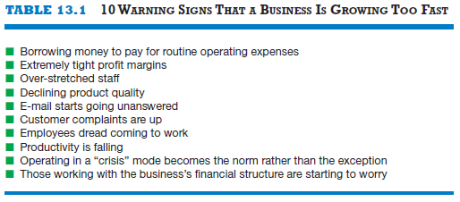
10 Warning Signs That a Business is Growing Too Fast
Copyright ©2012 Pearson Education, Inc. publishing as Prentice Hall
13-<number>

Slide 8
Reasons for Growth
1 of 3
Reason for Growth
Explanation
Economies of scale
Occur when increasing production lowers the average cost of each unit produced.
Economies of scope
Occur when the scope (or range) of a firm’s operations creates efficiencies.
Copyright ©2012 Pearson Education, Inc. publishing as Prentice Hall
13-<number>

Slide 9
Reasons for Growth
2 of 3
Reason for Growth
Explanation
Occurs when a firm holds the number one or the number two position in an industry or niche market in terms of sales volume.
Market Leadership
Influence, Power, and Survivability
Larger businesses usually have more influence and power than smaller firms.
Copyright ©2012 Pearson Education, Inc. publishing as Prentice Hall
13-<number>

Slide 10
Reasons for Growth
3 of 3
Reason for Growth
Explanation
Accommodate the Growth of Key Customers
Sometimes firms are compelled to grow to accommodate the growth of a key customer.
Attract and Retain Talented Employees
Growth is a firm’s primary mechanism to generate promotional opportunities for employees.
Copyright ©2012 Pearson Education, Inc. publishing as Prentice Hall
13-<number>

Slide 11
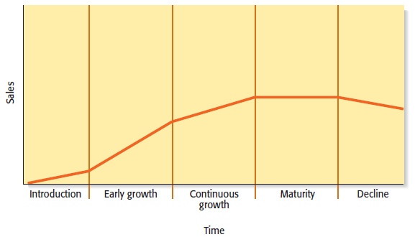
Managing Growth
It’s important for a business owner to know the stages of growth, along with the unique opportunities and challenges that each stage entails.
Copyright ©2012 Pearson Education, Inc. publishing as Prentice Hall
13-<number>

Slide 12
Stages of Growth
1 of 5
Introduction
  Start-up phase where a business determines what its core strengths and capabilities are.
  The main challenge is to make sure the initial product or service is right.
  It’s important to document what works and what doesn’t work during this stage.
Copyright ©2012 Pearson Education, Inc. publishing as Prentice Hall
13-<number>

Slide 13
Stages of Growth
2 of 5
Early Growth
  Generally characterized by increasing sales and heightened complexity.
  Two important things must happen for a business to be successful in this stage.
    The founder must start working “on the business” rather than “in the business.”
    Increased formalization must take
    place, and the business has to start
    developing policies and procedures.
Copyright ©2012 Pearson Education, Inc. publishing as Prentice Hall
13-<number>

Slide 14
Stages of Growth
3 of 5
Continuous Growth
  The need for structure and formalization increases.
  Often the business will start developing related products and services.
  The toughest decisions take place in this stage.
  One tough decision is whether the owner of the business and the current management
  team have the experience and
  the ability to take the business
  further.
Copyright ©2012 Pearson Education, Inc. publishing as Prentice Hall
13-<number>

Slide 15
Stages of Growth
4 of 5
Maturity
  A business enters the maturity stage when its growth stalls.
  At this point, a firm is typically more intently focused on managing efficiently than developing new products.
  Well-managed firms often look for partnering opportunities or opportunities for acquisitions or licensing deals to breathe new life into the firm.
  If new growth cannot be achieved
  through a firm’s existing product
  mix, the “next generation” of
  products should be developed.
Copyright ©2012 Pearson Education, Inc. publishing as Prentice Hall
13-<number>

Slide 16
Stages of Growth
5 of 5
Decline
  It is not inevitable that a business enter the decline stage.
  Many American businesses have long histories and have adapted and survived over time.
  A business’s ability to avoid decline hinges on the strength of its leadership and its ability to adapt over time.
Copyright ©2012 Pearson Education, Inc. publishing as Prentice Hall
13-<number>

Slide 17
Challenges of Growth
Managerial Capacity Problem
Day-to-Day Challenges of
Growing a Firm
Two categories of challenges for firm growth
Copyright ©2012 Pearson Education, Inc. publishing as Prentice Hall
13-<number>

Slide 18
Managerial Capacity Problem
1 of 6
Managerial Capacity
  Firms are collections of productive resources that are organized in an administrative framework.
  As a firm goes about its routine activities, it recognizes opportunities to grow.
  The problem with this scenario is that firms are not always prepared or able to grow, because of limited “managerial capacity.”
Copyright ©2012 Pearson Education, Inc. publishing as Prentice Hall
13-<number>

Slide 19
Managerial Capacity Problem
2 of 6
A Firm’s Administrative Framework
  A firm’s administrative framework consists of two kinds of services that are important to firm growth.
    Entrepreneurial services generate new market, product, and service ideas, while managerial services administer the routine functions of the firm and facilitate the profitable execution of new opportunities.
    New product and service ideas require substantial managerial services (or managerial capacity) to be successfully implemented.
    This is a complex problem because if a firm has insufficient managerial services to properly implement its new product and service ideas, it can’t grow.
Copyright ©2012 Pearson Education, Inc. publishing as Prentice Hall
13-<number>

Slide 20
Managerial Capacity Problem
3 of 6
A Firm’s Administrative Framework (continued)
  Continuation From Previous Slide
    The reason a firm can’t quickly increase its managerial services (to take advantage of new product or service ideas) is that it is expensive to hire new employees, it takes time for new hires to be socialized into the culture of a firm, and it takes time for new employees to acquire firm-specific skills and establish trusting relationships with other members of the firm.
    When a firm’s managerial resources are insufficient to take advantage of its new product and service opportunities, the subsequent bottleneck is referred to as the managerial capacity problem.
Copyright ©2012 Pearson Education, Inc. publishing as Prentice Hall
13-<number>

Slide 21
Managerial Capacity Problem
4 of 6
Additional Challenges
  As a firm grows, it is faced with the dual challenges of adverse selection and moral hazard.
    Adverse selection means that as the number of employees a firm needs increases, it becomes increasingly difficult for the firm to find the right employees, place them in appropriate positions, and provide adequate supervision.
    Moral hazard means that as a firm grows and adds personnel, the new hires typically do not have the same ownership incentives as the original founders, so the new hires may not be as motivated as the founders to put in long hours and may even try to avoid hard work.
Copyright ©2012 Pearson Education, Inc. publishing as Prentice Hall
13-<number>

Slide 22
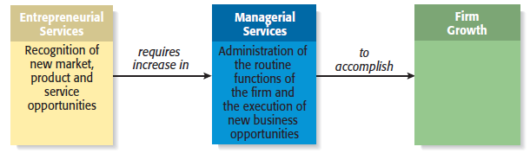
Managerial Capacity Problem
5 of 6
Basic Model of Firm Growth
Copyright ©2012 Pearson Education, Inc. publishing as Prentice Hall
13-<number>

Slide 23
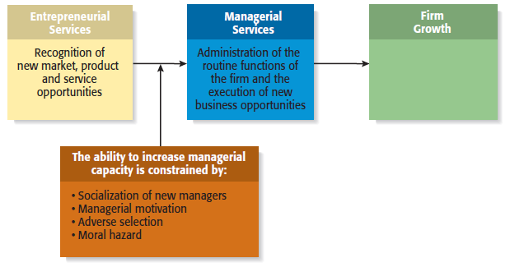
Managerial Capacity Problem
6 of 6
Impact of the Managerial Capacity Problem
Copyright ©2012 Pearson Education, Inc. publishing as Prentice Hall
13-<number>

Slide 24
Day-to-Day Challenges of Growing a Firm
1 of 3
Challenge
Explanation
Cash Flow Management
A firm requires an increasing amount of cash as it grows.
If growth comes at the expense of a competitor’s market share, a price war could ensue.
Price Stability
Copyright ©2012 Pearson Education, Inc. publishing as Prentice Hall
13-<number>

Slide 25
Day-to-Day Challenges of Growing a Firm
2 of 3
Challenge
Explanation
An increase in firm activity can result in quality control issues if a firm is not able to increase its resources to handle the extra work
Quality Control
Capital Constraints
Capital constraints are an ever-present problem for growing firms
Copyright ©2012 Pearson Education, Inc. publishing as Prentice Hall
13-<number>

Slide 26

Day-to-Day Challenges of Growing a Firm
3 of 3
These two female
entrepreneurs just
launched a casual
dining restaurant.
Their ability to grow
the business successfully
will hinge largely on
how they manage the
day-to-day challenges
of growing a firm.
Copyright ©2012 Pearson Education, Inc. publishing as Prentice Hall
13-<number>

Slide 27

All rights reserved. No part of this publication may be reproduced, stored in a retrieval system, or transmitted, in any form or by any means, electronic, mechanical, photocopying, recording, or otherwise, without the prior written permission of the publisher. Printed in the United States of America.
Copyright ©2012 Pearson Education, Inc. publishing as Prentice Hall
Copyright ©2012 Pearson Education, Inc. publishing as Prentice Hall
13-<number>

